Slide 1

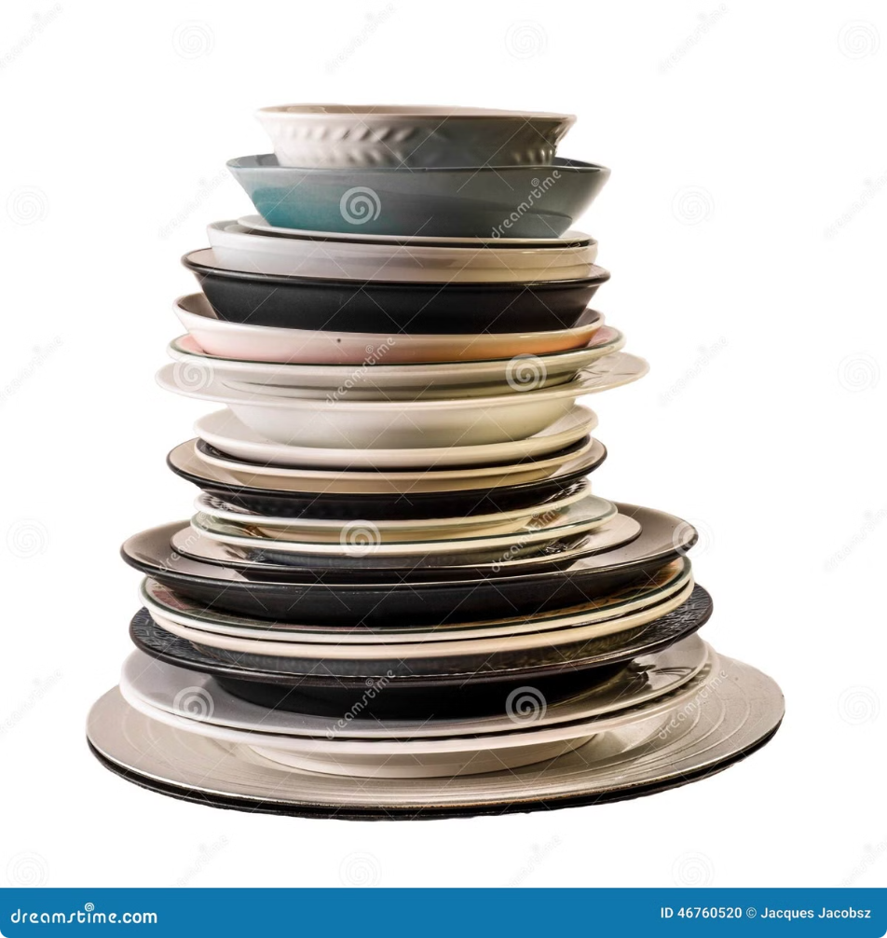
Stack vs. Queue: Exploring Abstract Data Types
Abstract Data Types (ADTs) are fundamental building blocks in computer science that define the basic operations and behaviors of data structures. This presentation explores the differences between two widely used ADTs: the Stack and the Queue.

Slide 2

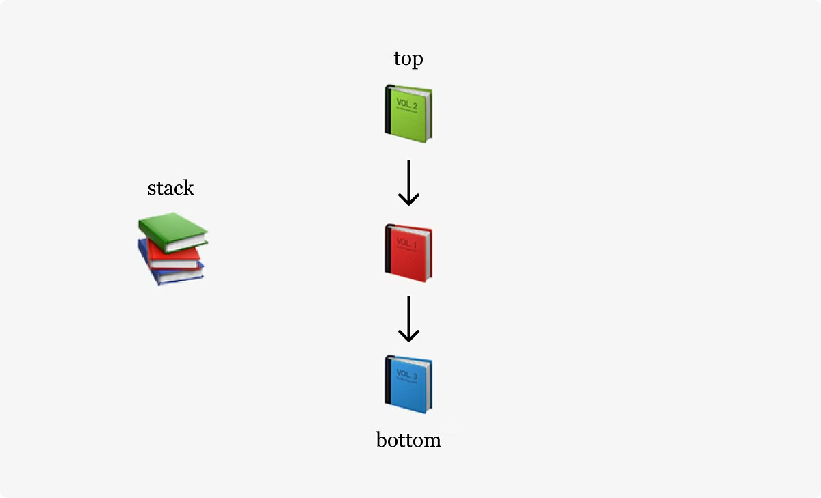
Definition of Stack (LIFO)
Last-In-First-Out
Efficient Access
A Stack is an ADT that follows the Last-In-First-Out (LIFO) principle. This means that the most recently added item is the first one to be removed.
Stacks are designed for efficient access and manipulation of data at the top, making them useful for a variety of applications such as function call management and expression evaluation.

Slide 3
Real-world Analogy: Cafeteria Plate Stack
Plate Stack
LIFO Principle
Imagine a stack of plates in a cafeteria line. The last plate added to the stack is on top and is the first one taken when someone needs a plate.
This real-world example demonstrates the LIFO (Last-In-First-Out) principle of a Stack, where the most recently added item is the first one to be removed.

Slide 4

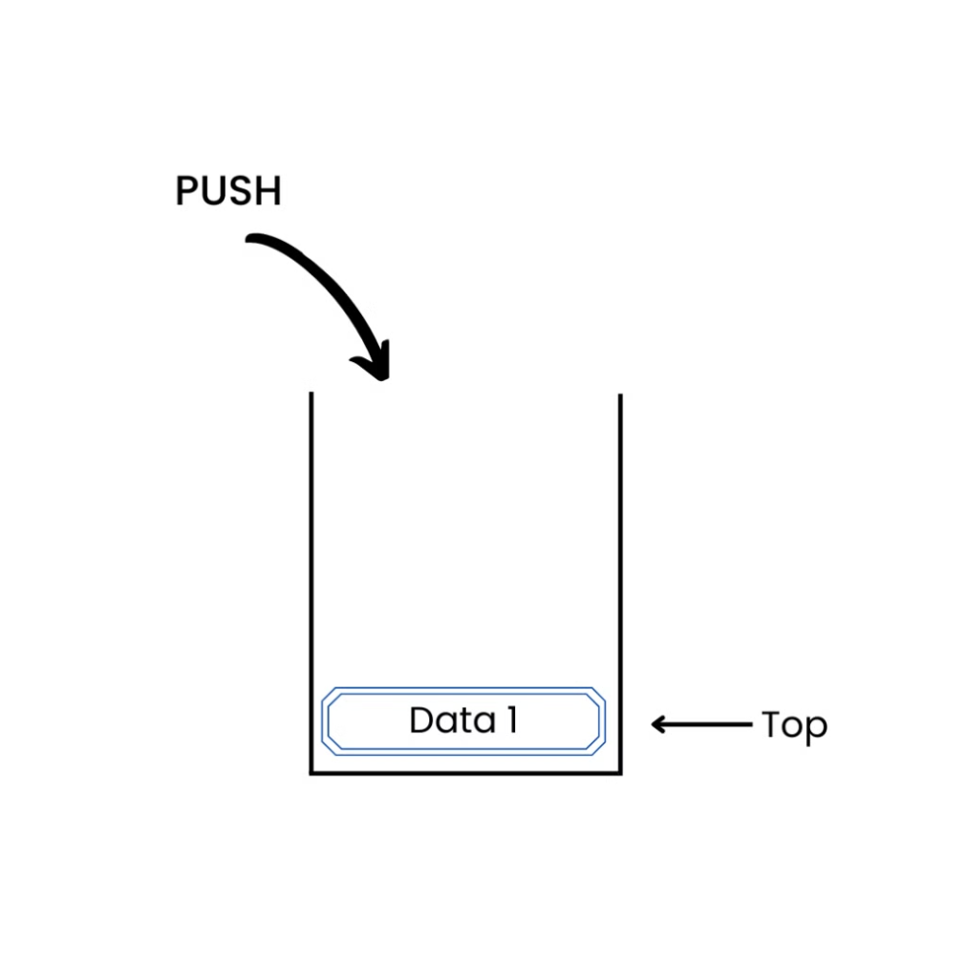
Stack Operations: Push
1
Adding to the Stack
The Push operation adds a new element to the top of the Stack.
2
Efficient Access
Pushing an element to the top of the Stack allows for quick and efficient access to the most recently added data.
3
LIFO Principle
The pushed element becomes the new top of the Stack, following the Last-In-First-Out principle.

Slide 5

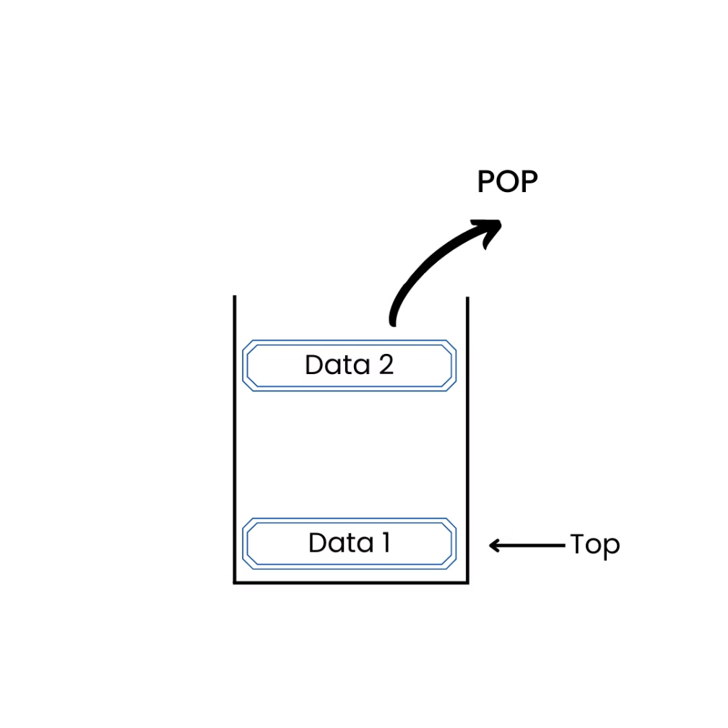
Stack Operations: Pop
1
Removing from the Stack
The Pop operation removes the topmost element from the Stack.
2
LIFO Principle
The Pop operation follows the Last-In-First-Out principle, removing the most recently added element.
3
Efficient Retrieval
Popping an element from the top of the Stack allows for quick and efficient access to the most recent data.

Slide 6

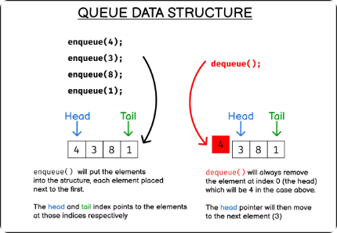
Definition of Queue (FIFO)
First-In-First-Out
Sequential Access
A Queue is an ADT that follows the First-In-First-Out (FIFO) principle. This means that the first element added to the Queue is the first one to be removed.
Queues are designed for sequential access, where elements are added at the rear and removed from the front, making them useful for tasks like job scheduling and event handling.

Slide 7
Real-world Analogy: Line at a Bank
Bank Line
FIFO Principle
Imagine a line of people waiting to be served at a bank. The first person in line is the first one to be helped, following the FIFO (First-In-First-Out) principle.
This real-world example demonstrates the FIFO (First-In-First-Out) principle of a Queue, where the first element added is the first one to be removed.

Slide 8

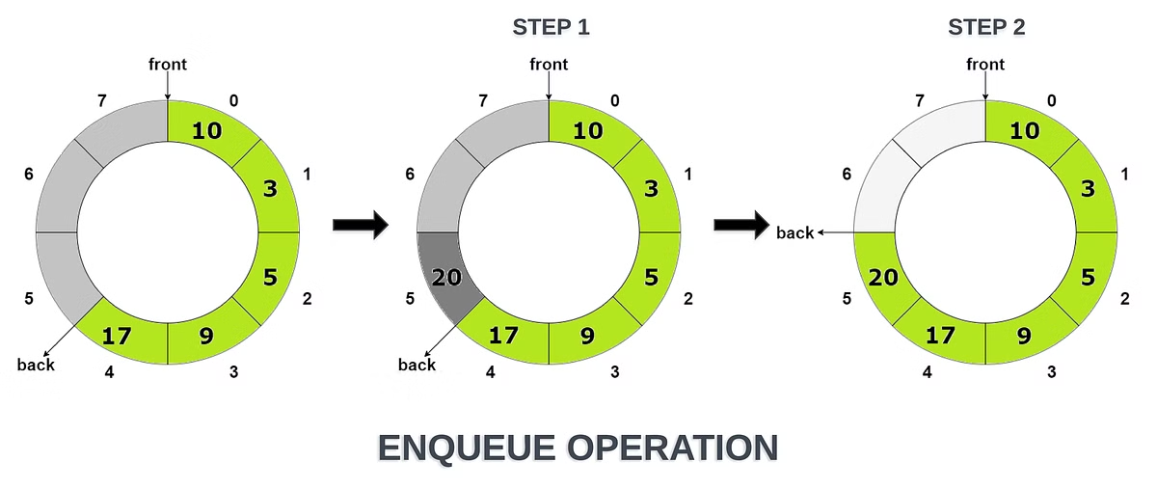
Queue Operations: Enqueue
1
Adding to the Queue
The Enqueue operation adds a new element to the rear of the Queue.
2
Sequential Access
Enqueuing an element at the rear of the Queue allows for sequential access, following the FIFO principle.
3
Efficient Handling
The Enqueue operation is efficient for tasks that require elements to be processed in the order they were added.

Slide 9

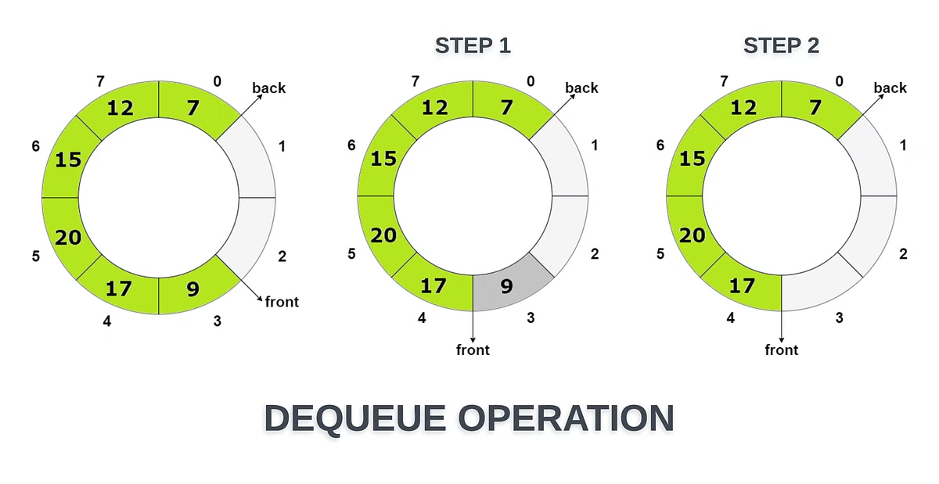
Queue Operations: Dequeue
1
Removing from the Queue
The Dequeue operation removes the element from the front of the Queue.
2
FIFO Principle
Dequeueing an element from the front of the Queue follows the First-In-First-Out principle.
3
Efficient Retrieval
The Dequeue operation allows for efficient access to the oldest data in the Queue.

Slide 10
Key Differences and Use Cases
Stack
Queue
Differences
Stacks are useful for tasks like expression evaluation, function call management, and backtracking algorithms, where the most recently added item needs to be accessed first.
Queues are well-suited for tasks that require sequential processing, such as job scheduling, event handling, and resource allocation, where the first added item needs to be processed first.
The key difference between Stacks and Queues is the order in which elements are accessed: Stacks follow LIFO, while Queues follow FIFO.

Slide 11

Comparing Bubble Sort and Quick Sort
We'll explore two fundamental sorting algorithms: Bubble Sort and Quick Sort. These algorithms showcase different approaches to organizing data efficiently.

Slide 12
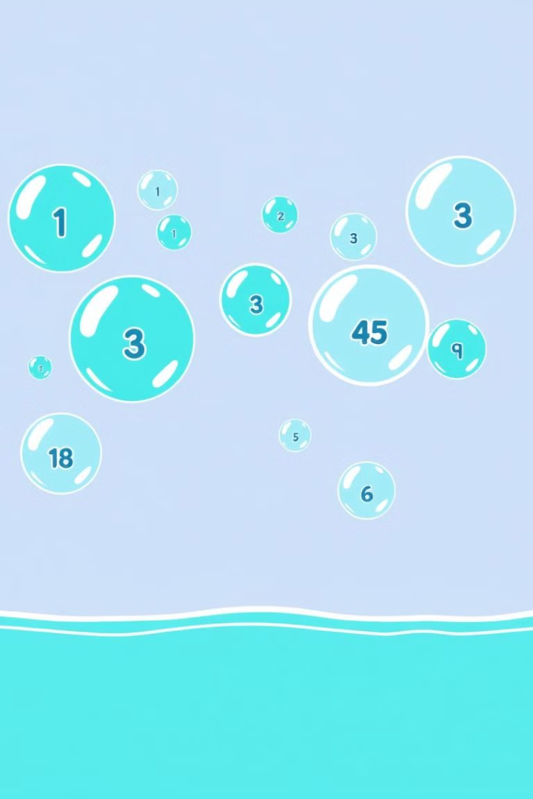



Bubble Sort: An Overview
Comparison-Based
Bubble Sort compares adjacent elements and swaps them if they're in the wrong order.
Iterative
The process repeats until the entire list is sorted, with no more swaps needed.
Simplicity
Known for its straightforward implementation, making it easy to understand and code.

Slide 13
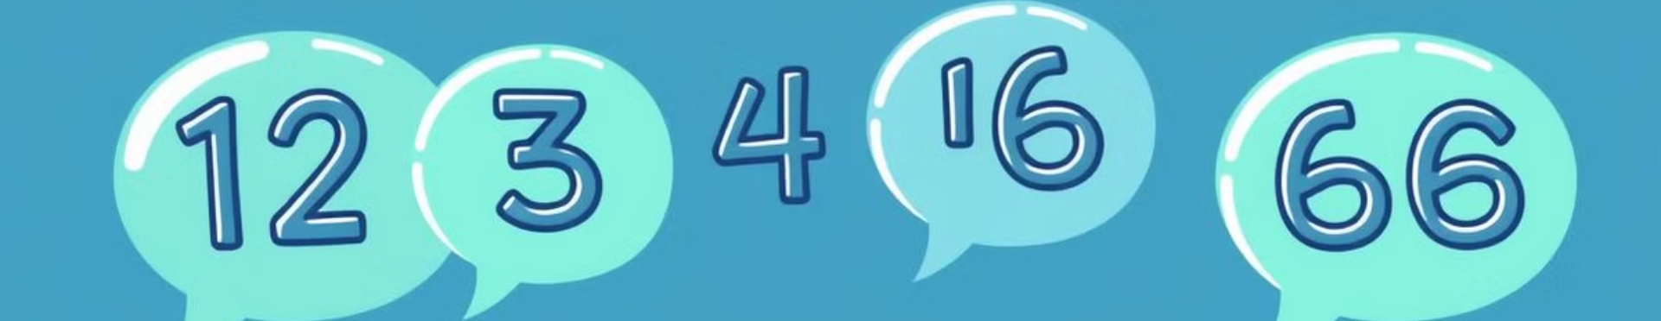
Definition of Bubble Sort
Comparison-Based
In-Place Algorithm
Stable Sort
Bubble Sort repeatedly steps through the list, comparing adjacent elements and swapping them if they're in the wrong order.
It sorts the elements within the given array without requiring additional memory space.
Bubble Sort maintains the relative order of equal elements in the sorted output.

Slide 14
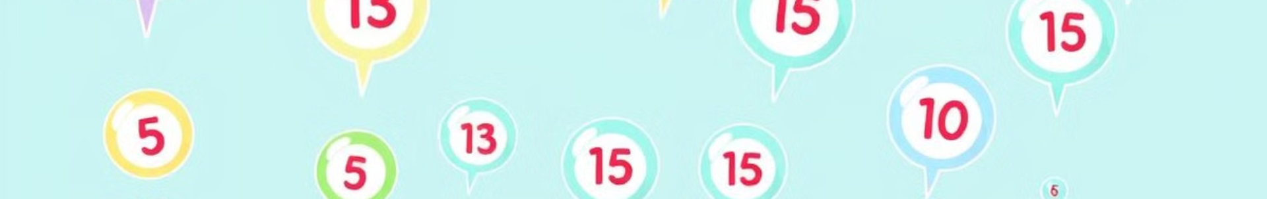
Mechanism of Bubble Sort
Start
1
Begin with the first element of the array. Compare it with the next element.
2
Compare and Swap
If the first element is greater, swap them. Move to the next pair.
Repeat
3
Continue this process for the entire array. Larger elements "bubble up" to the end.
4
Multiple Passes
Repeat the entire process until no more swaps are needed. The array is now sorted.

Slide 15
Advantages and Disadvantages of Bubble Sort
Advantages
Disadvantages
Simple to understand and implement
Poor time complexity of O(n²)
Requires minimal additional memory
Inefficient for large datasets
Detects if the list is already sorted
Performs poorly compared to advanced algorithms

Slide 16




Quick Sort: An Overview
Divide and Conquer
Quick Sort uses a divide-and-conquer strategy to efficiently sort elements.
Pivot-Based
It selects a 'pivot' element and partitions the array around it.
Recursive
The algorithm recursively applies the same process to smaller subarrays.

Slide 17
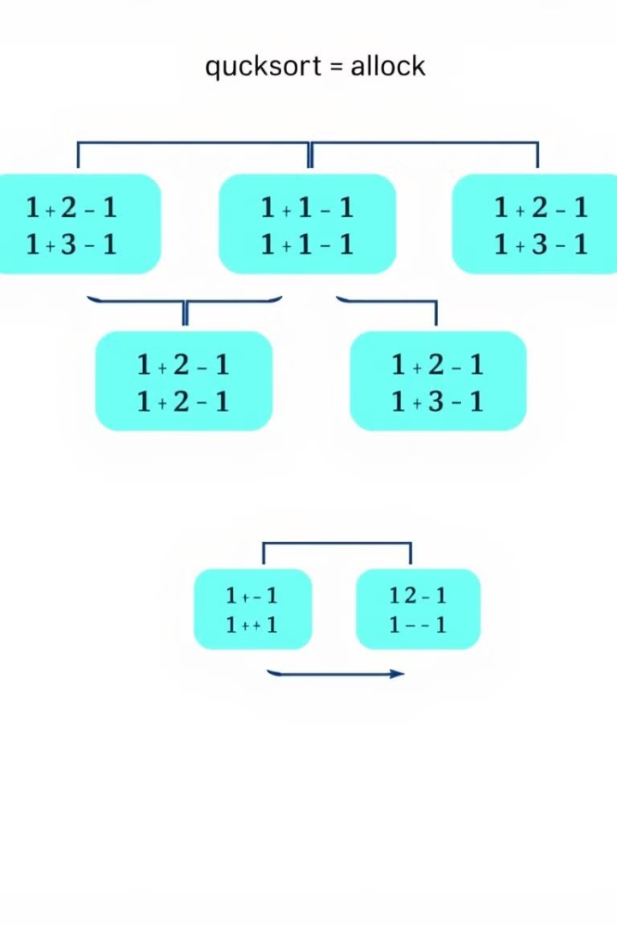
Definition of Quick Sort
Divide-and-Conquer
Partitioning
It uses a pivot element to partition the array into two halves.
Quick Sort divides the array into smaller subarrays, sorts them independently, and combines the results.
In-Place Sorting
Quick Sort typically sorts the array in-place, minimizing additional memory usage.

Slide 18
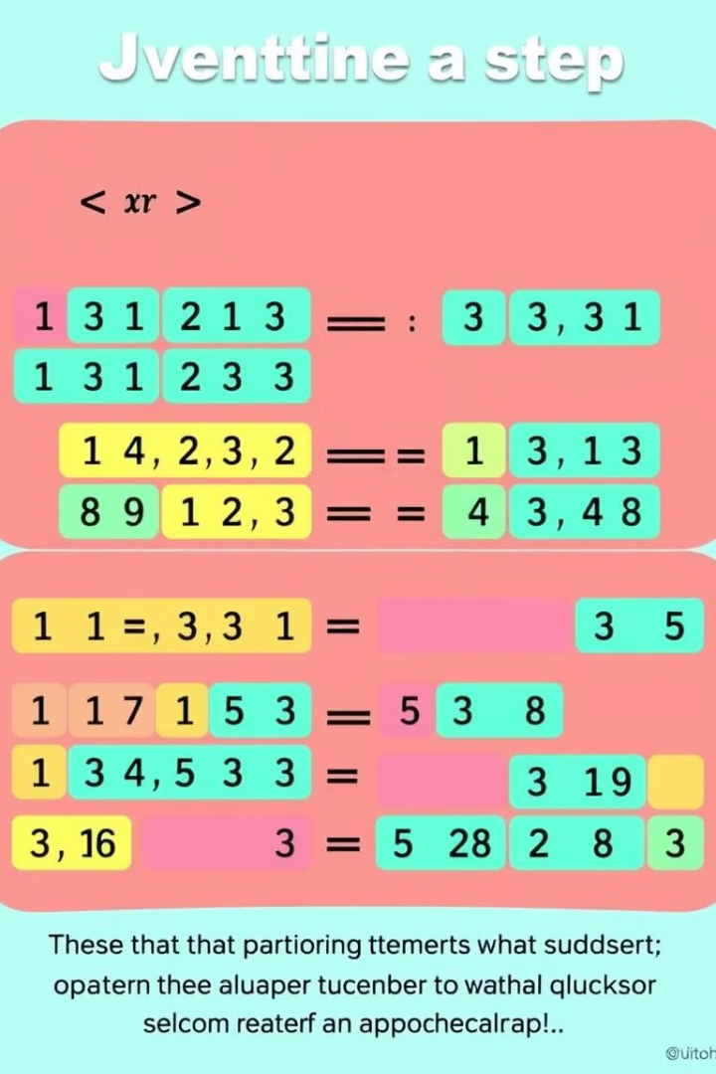
Mechanism of Quick Sort
1
Choose Pivot
Select a pivot element from the array, often the last or a random element.
2
Partitioning
Rearrange the array so elements smaller than the pivot are on the left, larger on the right.
3
Recursive Sorting
Recursively apply Quick Sort to the subarrays on the left and right of the pivot.
4
Combine
The sorted subarrays are already in place, forming the final sorted array.

Slide 19
Advantages and Disadvantages of Quick Sort
Advantages
Disadvantages
Efficient for large datasets
Worst-case time complexity of O(n²)
Average time complexity of O(n log n)
Not stable (may change order of equal elements)
In-place sorting with low memory usage
Performance depends on pivot selection

Slide 20
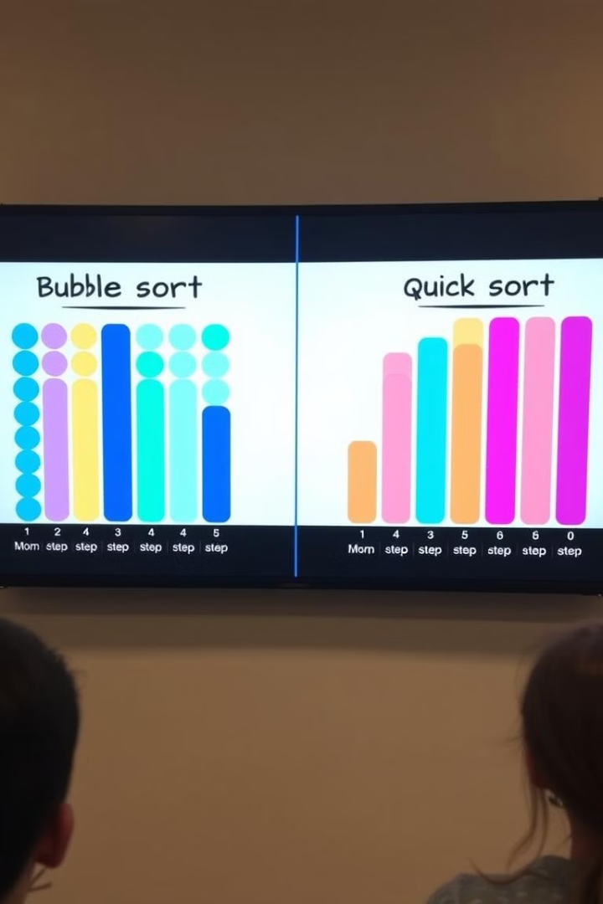
Comparison of Bubble Sort and Quick Sort
Aspect
Bubble Sort
Quick Sort
Time Complexity (Average)
O(n²)
O(n log n)
Space Complexity
O(1)
O(log n)
Stability
Stable
Not Stable
Efficiency for Large Datasets
Poor
Excellent
Implementation Complexity
Simple
Moderate

Slide 21

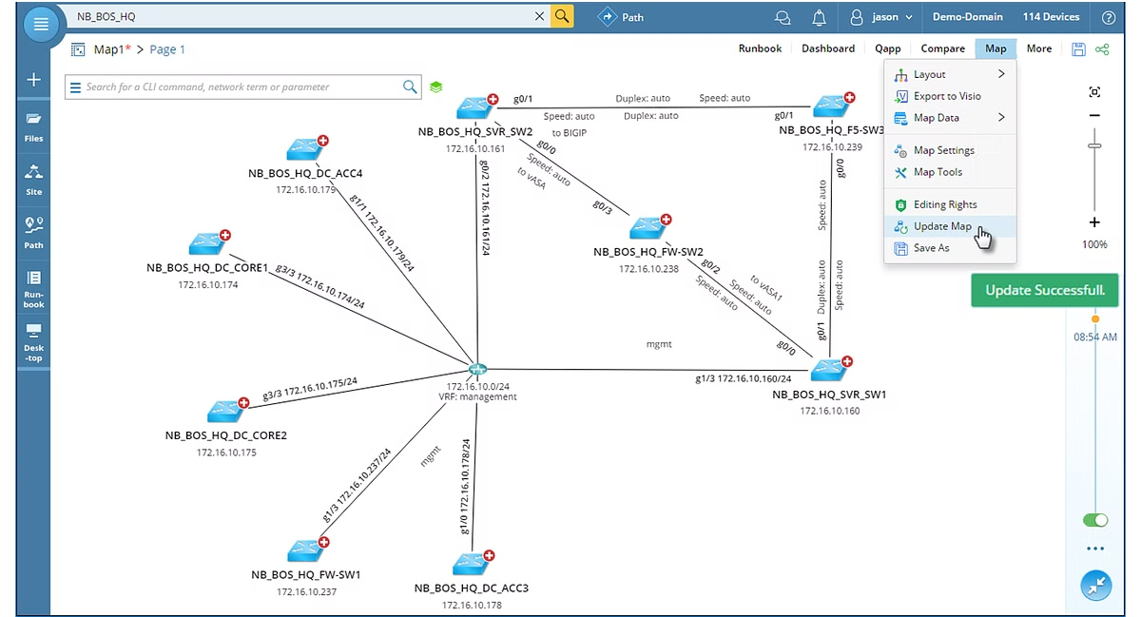
Network Shortest Path Algorithms
In graph theory, shortest path algorithms are used to find the minimum distance between nodes in a network. Two commonly used algorithms for this are Dijkstra's and Bellman-Ford, each with their own strengths and applications.

Slide 22

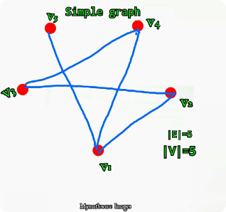
Introduction to Shortest Path Algorithms
1
Efficient Routing
2
Path Planning
3
Network Analysis
Shortest path algorithms are crucial for optimizing network traffic and reducing travel time.
These algorithms have applications in GPS navigation, logistics, and transportation planning.
Identifying critical nodes and connections can help analyze and improve network infrastructure.

Slide 23

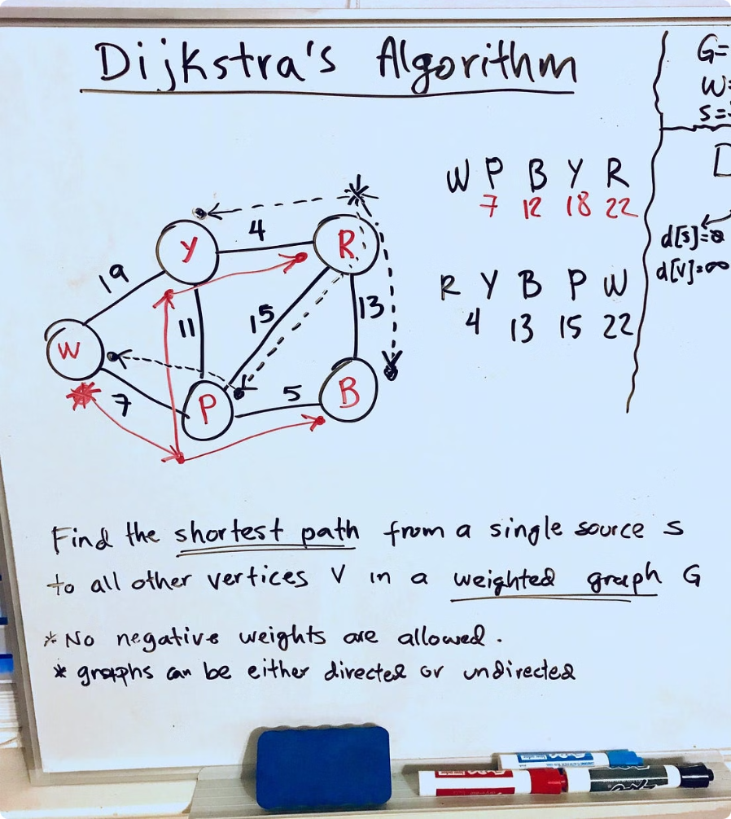
Dijkstra's Algorithm
1
Initialize
Set the source node distance to 0 and all other nodes to infinity.
2
Select Minimum
Choose the unvisited node with the smallest known distance from the source.
3
Update Distances
Update the distance of all unvisited neighbors of the selected node.

Slide 24

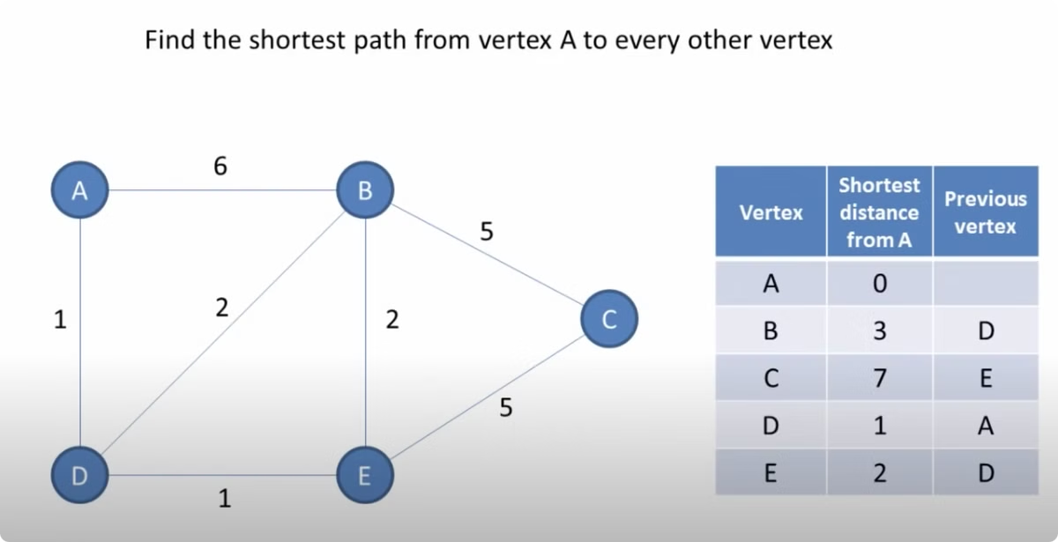
Dijkstra's Algorithm: Definition
Weighted Graphs
Single Source
Dijkstra's algorithm works on weighted, directed graphs without negative weights.
It finds the shortest paths from a single source node to all other nodes.
Greedy Approach
Time Complexity
The algorithm greedily selects the node with the smallest known distance.
With a min-heap, Dijkstra's algorithm has a time complexity of O(E log V).

Slide 25


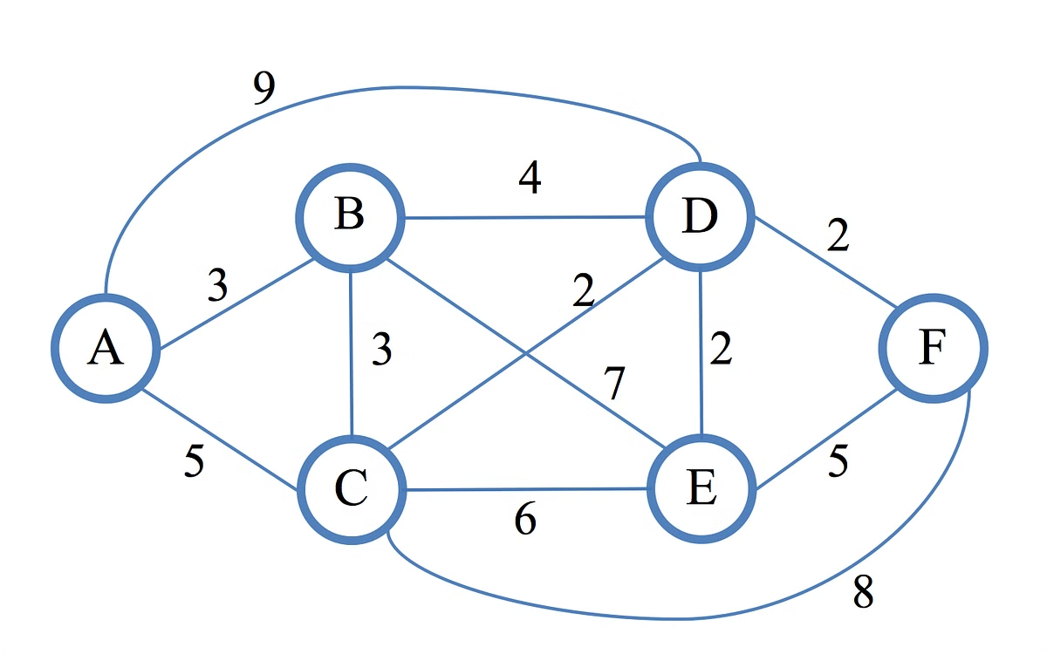
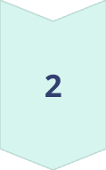
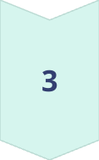
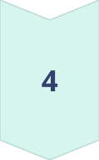
Dijkstra's Algorithm: Steps
Initialize
Set the source distance to 0 and all other nodes to infinity.
Select Minimum
Choose the unvisited node with the smallest known distance.
Update Distances
Update the distance of all unvisited neighbors of the selected node.
Repeat
Repeat the process until all nodes have been visited.

Slide 26
Dijkstra's Algorithm: Example
Weighted Graph
Step-by-Step
Optimal Paths
Consider a weighted, directed graph with 5 nodes and 7 edges.
Starting from node A, Dijkstra's algorithm iteratively finds the shortest paths to all other nodes.
The algorithm determines the shortest path from A to each node: A->B->D, A->C, A->D, A->E.

Slide 27

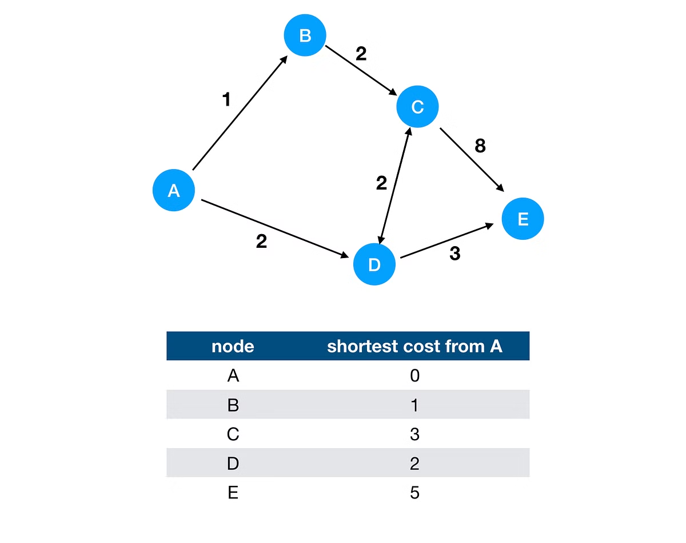
Bellman-Ford Algorithm
1
Initialize
Set the source node distance to 0 and all other nodes to infinity.
2
Relax Edges
Iterate through all edges, updating the distance of the destination node if a shorter path is found.
3
Check for Cycles
If the distances can be further reduced after V-1 iterations, there is a negative weight cycle.

Slide 28

Bellman-Ford Algorithm: Definition
Negative Weights
Single Source
Bellman-Ford can handle graphs with negative edge weights, unlike Dijkstra's algorithm.
It finds the shortest paths from a single source node to all other nodes.
Dynamic Programming
Time Complexity
Bellman-Ford has a time complexity of O(VE), making it slower than Dijkstra's for dense graphs.
The algorithm uses a dynamic programming approach to iteratively relax the edges.

Slide 29

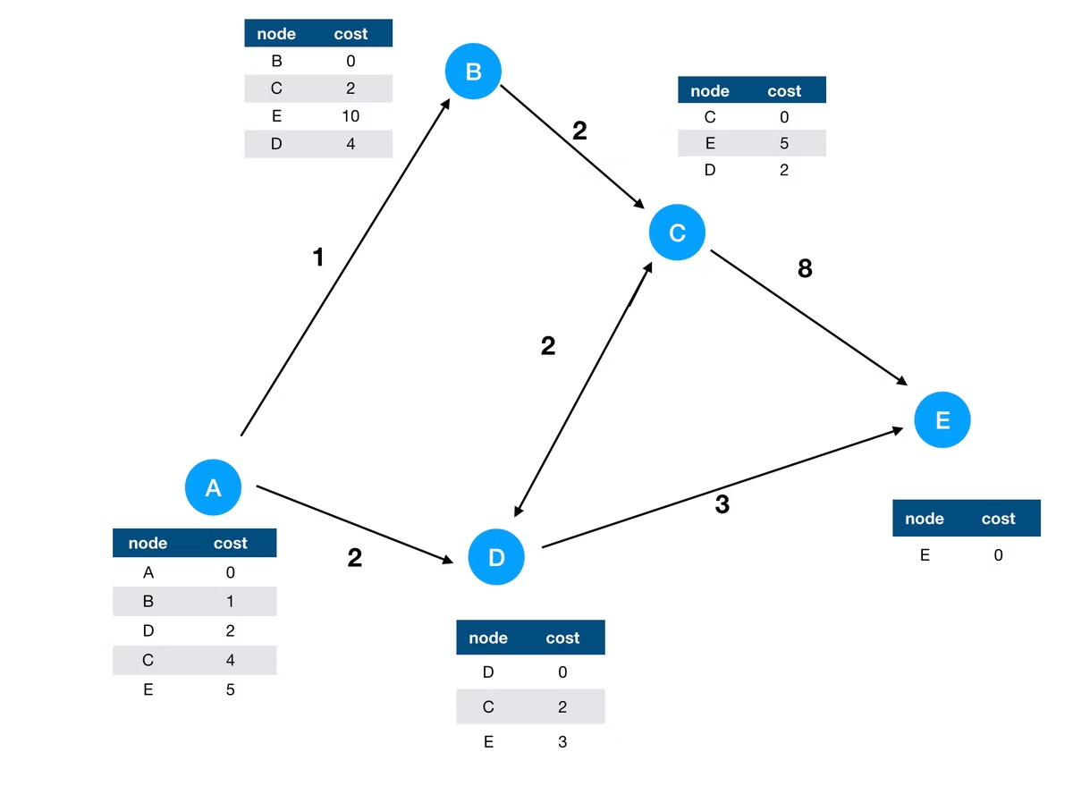
Bellman-Ford Algorithm: Steps
Initialize
Set the source distance to 0 and all other nodes to infinity.
Relax Edges
Iterate through all edges, updating the destination node distance if a shorter path is found.
Check for Cycles
If the distances can be further reduced after V-1 iterations, there is a negative weight cycle.
Output
The final distances represent the shortest paths from the source to all other nodes.

Slide 30
Comparison of Dijkstra and Bellman-Ford
Dijkstra's Algorithm
Bellman-Ford Algorithm
Applications
Efficient for dense graphs, but cannot handle negative weights.
Dijkstra is commonly used in GPS navigation, while Bellman-Ford is useful for routing with negative costs.
Can handle negative weights, but slower for dense graphs.

